Slide 1
Applications for Small Area Estimation Methods in Forest Inventories and Modeling Center for Intensive Planted-forest Silviculture
Bryce Frank, Temesgen Hailemariam & Francisco Mauro
February 2025

Slide 2
Outline
Part 1 (Introduction)
Regression estimator
Modelling at the unit level
Part 2 ( Applications for Unit-level Models in Forestry )
Small Area Estimation R packages and Data
SAE Direct Estimation
Class Exercise and Running Codes I
Part 3 (Applications for Area-level Models in Forestry )
Small Area Estimation R packages and Data
SAE Direct Estimation
Class Exercise and Running Codes II
Part 4 (Uncertainty Estimation)
Uncertainty Estimation
Variable Selection for SAE
Closing Thoughts and Future Direction

Slide 3
Part 1. Introduction
The objective of this section is to introduce the small area estimation problem.
To that end, we will revisit classical sampling techniques (i.e., design-based).
Then we will move forward to understand how model-based estimation works.
The introduction concludes presenting the small area estimation problem in the context of model-based estimation.

Slide 4
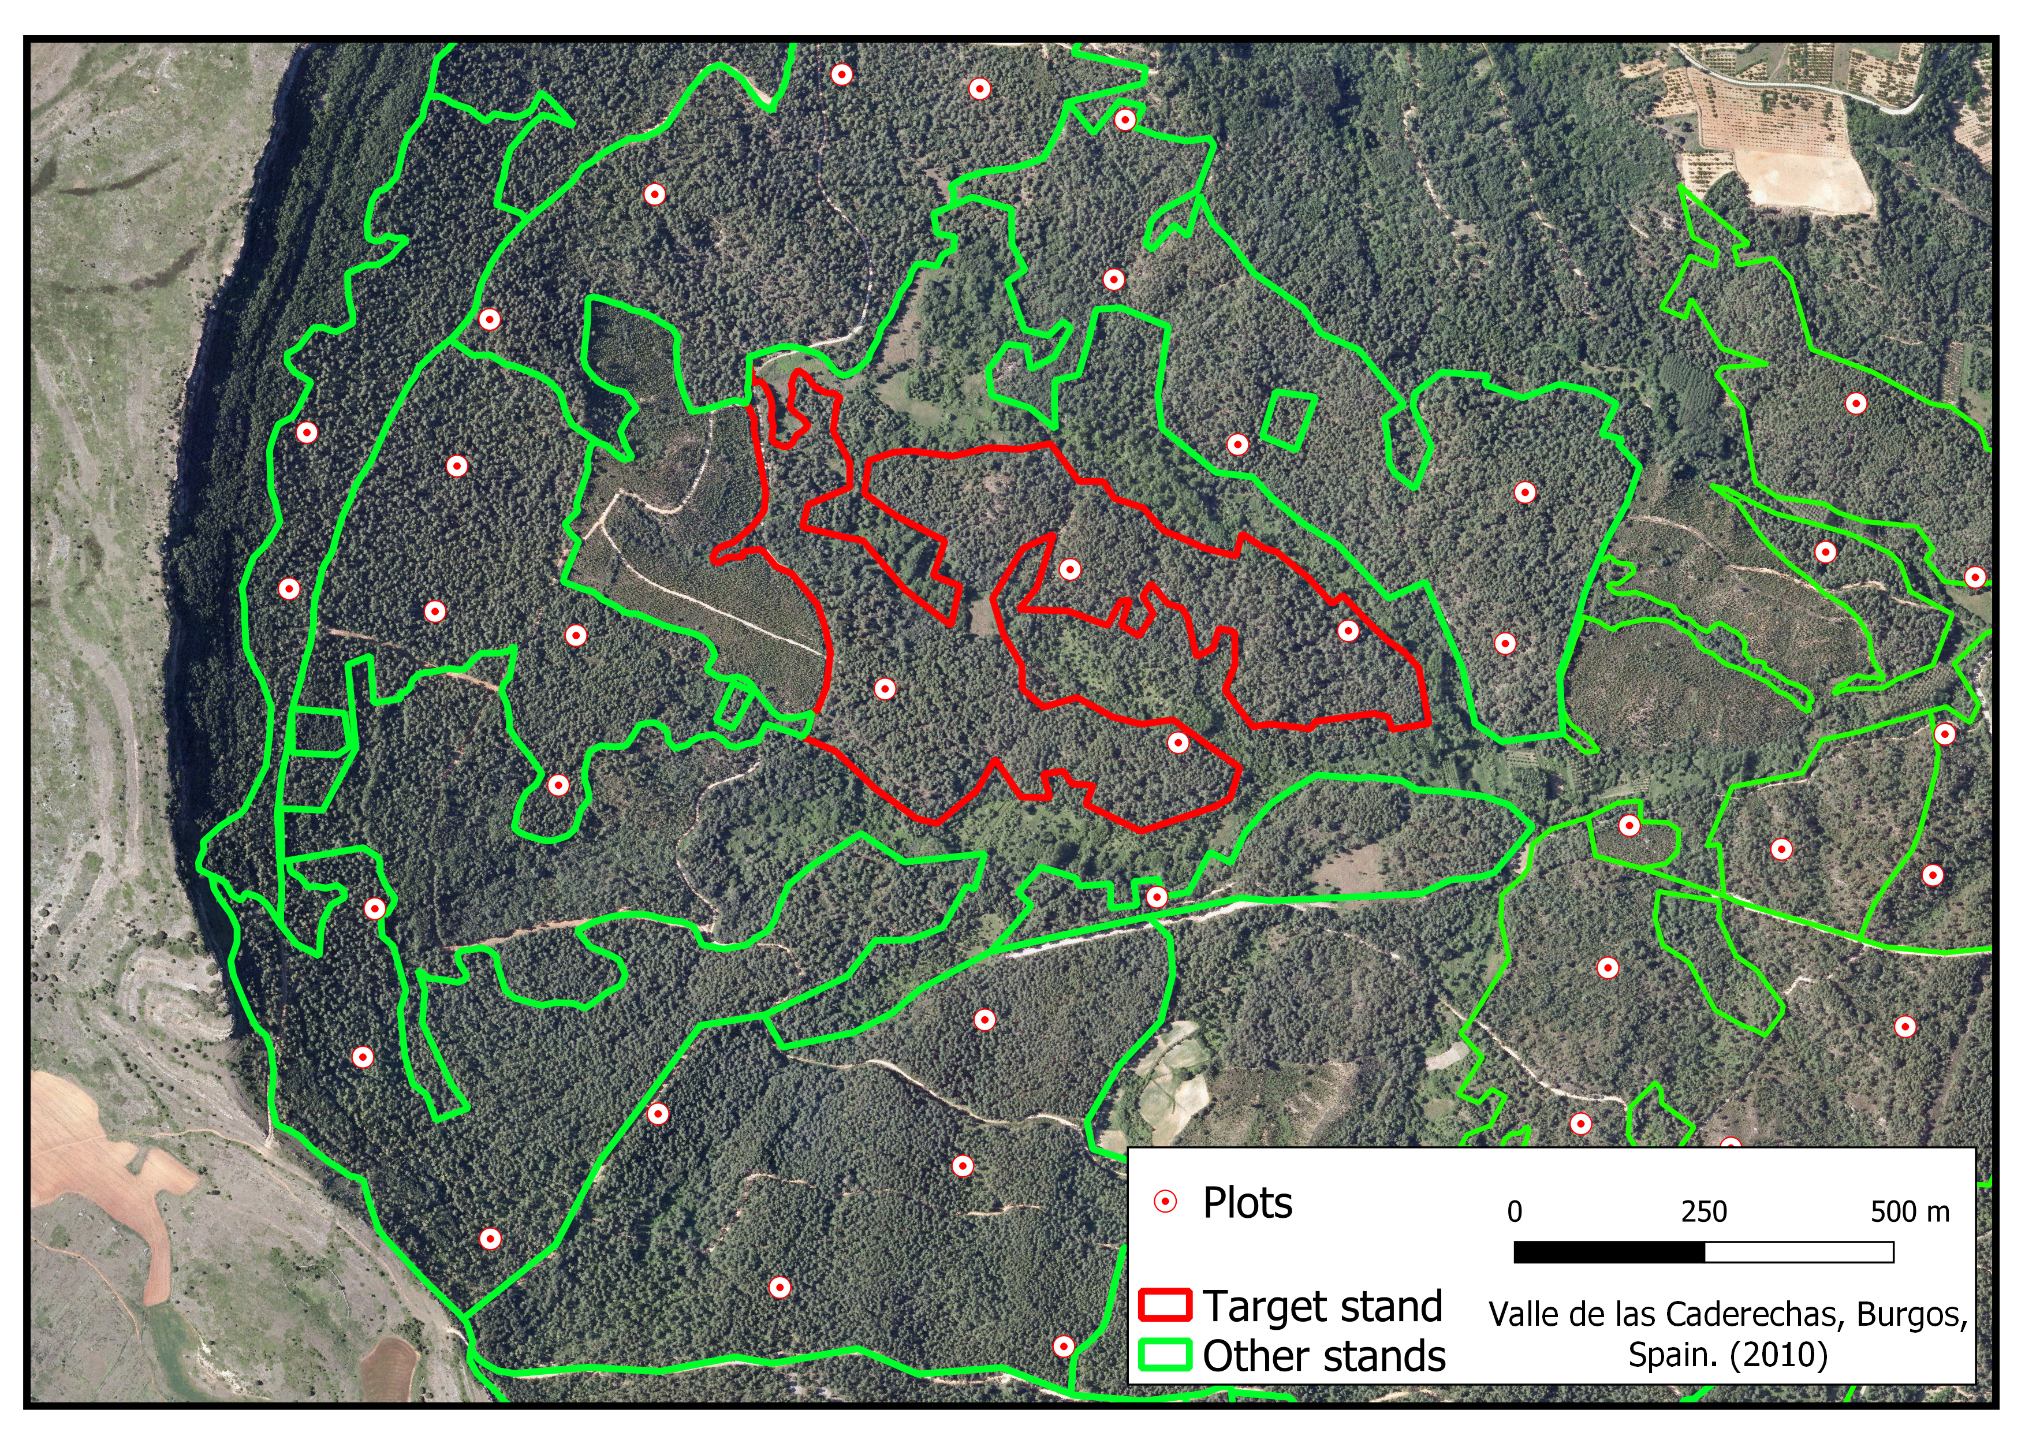
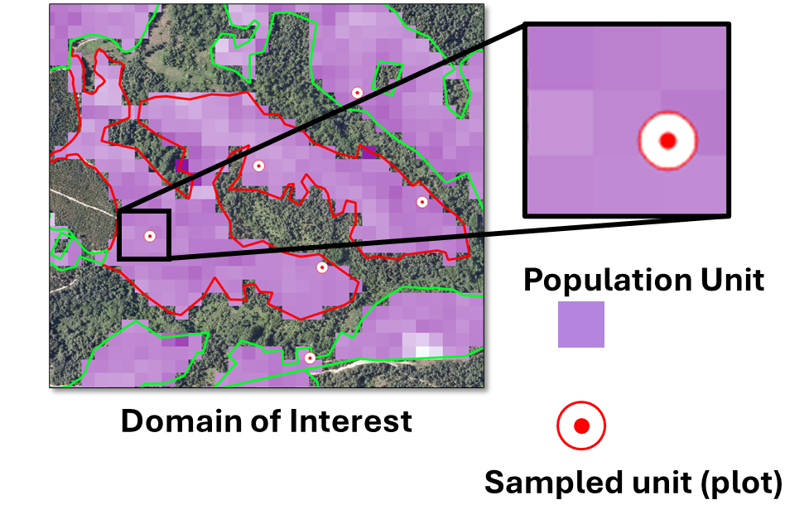
Part 1. Introduction
To focus on the main ideas of the course we are going use some simplifications and common notation.
Study area: A forest → Population (set of population units)→Enclosed in green polygons
Domains of interest: Stands → Subpopulation (Subsets of units of the population, typically based on a delineation). →E.g., red polygon.
Population unit: Pixels → grid cells with available auxiliary information (e.g. from lidar) with sizes ~ 1/10th acre
Sampled units: Field plots → assumed equivalent to population units ~1/10th acre
Aux info: color coded

Slide 5
Part 1. Estimators based on sampling design
When working with classical sampling methods (i.e., design based):
Each population unit has an UNKNOWN BUT FIXED value for the variable of interest. This implies that target parameters such as means or totals are UNKNOWN BUT FIXED quantities.
Each population unit may have KNOWN BUT FIXED values for one or more auxiliary variables.
This starting point is very reasonable and do not imply any strong assumption about the population.
We cannot measure all population units so we will estimate parameters of interest about our population or about subpopulations using sampling.

Slide 6
Part 1. Estimators based on sampling design
When working with classical sampling methods (i.e., design based). We have to do five steps.
Define our target population parameter: e.g., Mean volume in the forest, total volume in the forest, mean volume in one stand… We cannot know it. It is a population parameter and we cannot measure the entire population We have to sample.
Establish randomized sampling design: e.g. simple random sampling, stratified…
Select estimator: Sample mean, stratified mean…
Collect the sample: We go to the field and measure units according to our design
Calculate our estimates and uncertainties: Using the collected data, we calculate our estimators and uncertainty for the chosen sampling design.
We decide what the sampling design is and what estimator we are going to use!!!

Slide 7
Part 1. Estimators based on sampling design
The two most important ideas so far are:
We do not make any strong assumption about the population.
Each population unit has an UNKNOWN BUT FIXED value for the variable of interest. This implies that target parameters such as means or totals are UNKNOWN BUT FIXED quantities.
Each population unit may have KNOWN BUT FIXED values for one or more auxiliary variable.
We decide what the sampling design is and what estimator we are going to use!!!

Slide 8
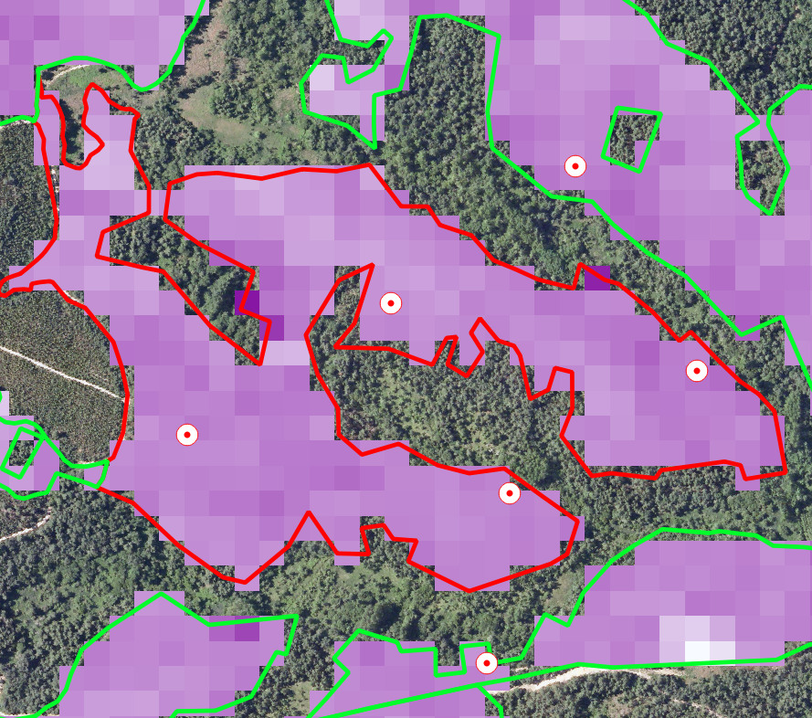
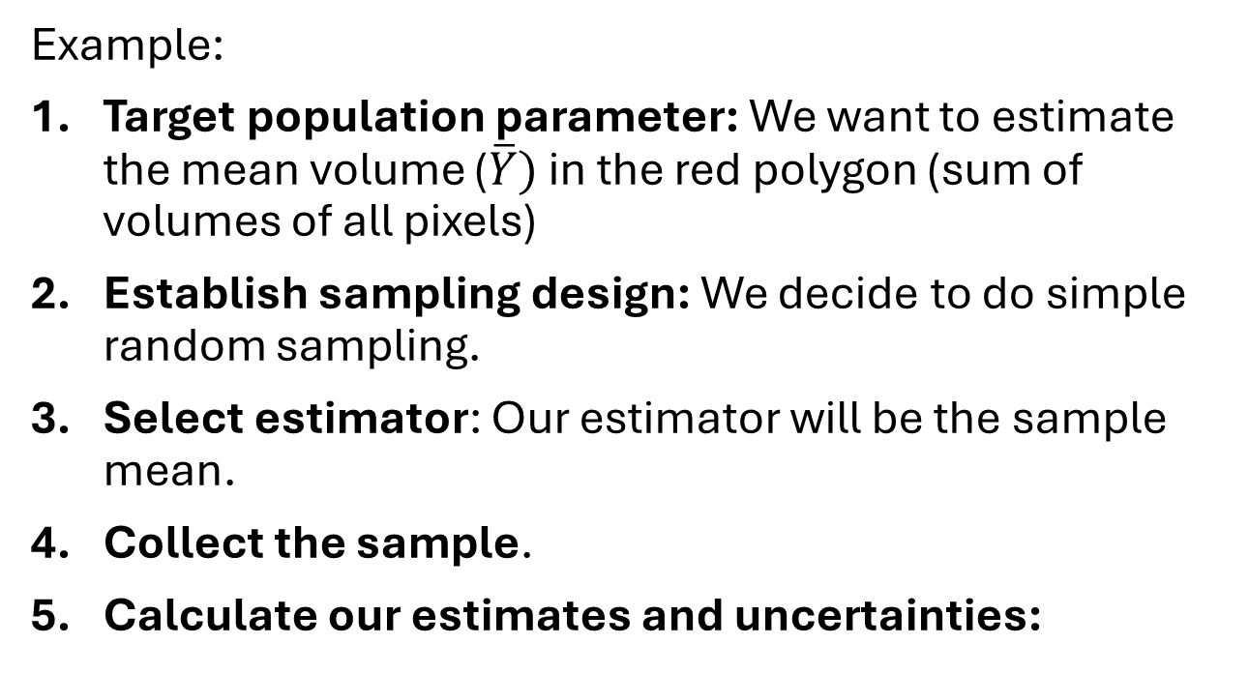
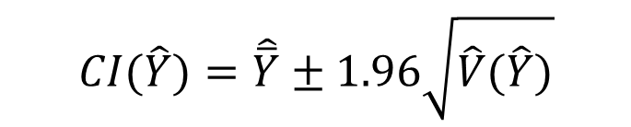
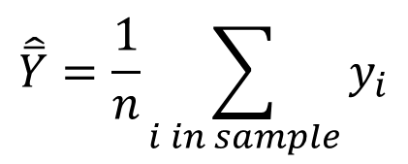
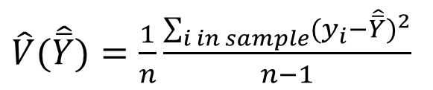
Part 1. Estimators based on sampling design
Example:
Target population parameter: We want to estimate the mean volume ($\overline{Y})$ in the red polygon (sum of volumes of all pixels)
Establish sampling design: We decide to do simple random sampling.
Select estimator: Our estimator will be the sample mean.
Collect the sample.
Calculate our estimates and uncertainties:
$$\hat{\overline{Y}}=\frac{1}{n}\sum_{i in sample}{y_{i}}$$
$$CI(\hat{Y})=\hat{\overline{Y}}±1.96\sqrt{\hat{V}(\hat{Y})}$$
$\hat{V}(\hat{\overline{Y}})=\frac{1}{n}\frac{\sum_{i in sample}{{{(y}_{i}−\hat{\overline{Y}})}^{2}}}{n−1}$

Slide 9
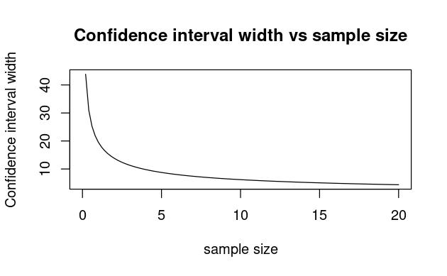

Part 1. Estimators based on sampling design
Uncertainty:
$$CI\left(\hat{Y}\right)=\hat{\overline{Y}}±1.96\sqrt{\hat{V}\left(\hat{Y}\right)}=\hat{\overline{Y}}±1.96\sqrt{\frac{1}{n}\frac{\sum_{i in sample}{{{(y}_{i}−\hat{\overline{Y}})}^{2}}}{n−1}}=$$
$$\hat{\overline{Y}}±1.96 sd(sample)\sqrt{\frac{1}{n}}$$
In design-based methods, the uncertainty (confidence interval width) tends to be proportional to the inverse of the square root of the sample size.
In many applications our sample sizes are in the blue area (large uncertainty)

Slide 10
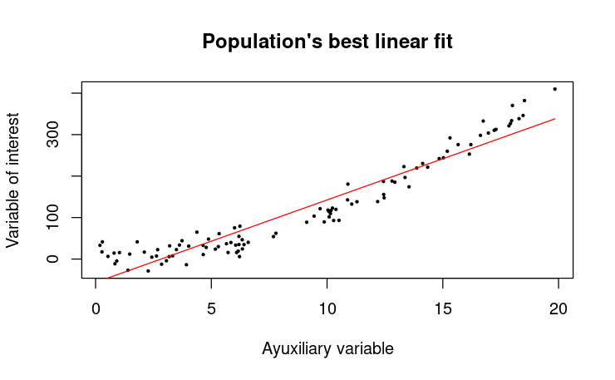
Part 1. Estimators based on sampling design
What can we do if the error is large?
If there is auxiliary information available we can use regression estimators.
All population units have a fixed and unknown value for the variable of interest (e.g., Volume) and values for some auxiliary variables (e.g., Lidar P95 purple)
For that population there is line of best fit.
We do not assume that the data is generated by that linear relationship, in this case the date seems to generate from something like a parabola.
The line is just the line of best fit for that population , but in this case gets reasonably close.

Slide 11
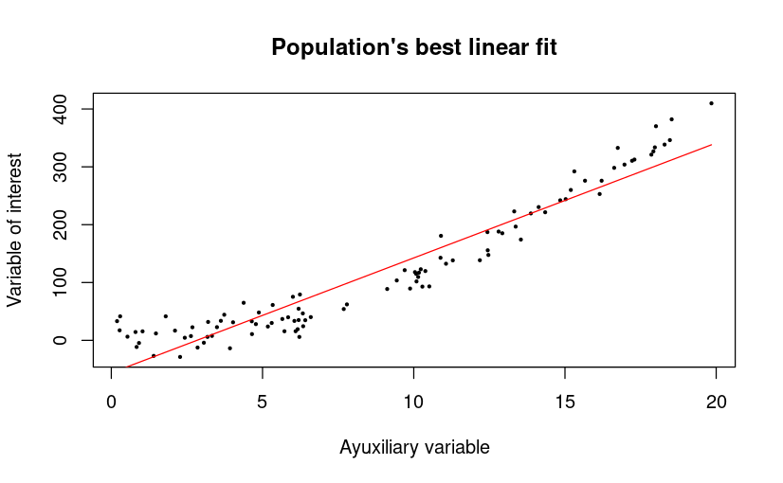
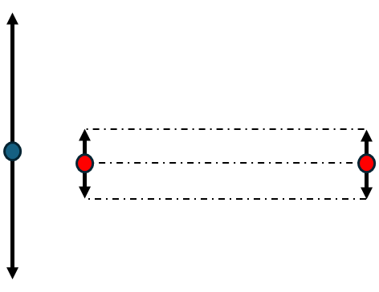
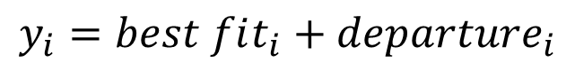

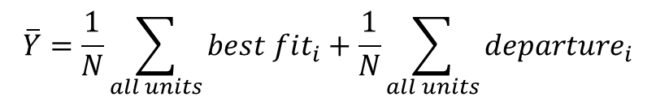
Part 1. Estimators based on sampling design
If we knew the line of best fit (fixed) we could calculate the adjusted value for any population unit and only consider the departures from that line (also fixed but unknown)
To estimate the population mean, the only thing we would need to estimate is the mean of the departures.
If the line of best fit represents the data well, then the variability that is left (departures) would be smaller than the variability of the variable of interest.
$$y_{i}=best fit_{i}+departure_{i}$$
$$\overline{Y}=\frac{1}{N}\sum_{all units}{best fit_{i}}+\frac{1}{N}\sum_{all units}{departure_{i}}$$
known
estimated
$$\hat{\overline{Y}}=\frac{1}{N}\sum_{all unit}{best fit_{i}}+\frac{1}{n}\sum_{i in sample}{departure_{i}}$$

Slide 12
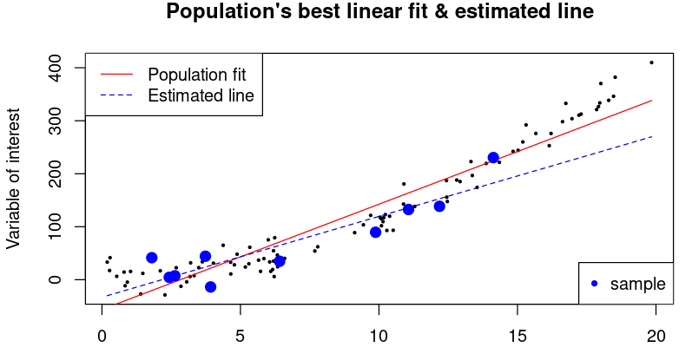
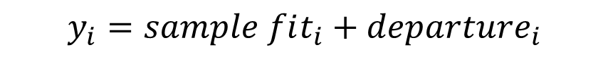
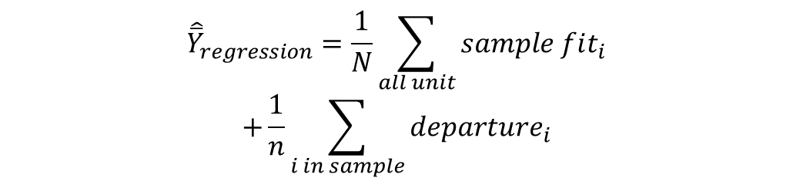
Part 1. Estimators based on sampling design
In practice, we do not know the line of best fit (red). What we do is, estimate that line (blue) with the sample (for SRS and systematic use OLS).
We estimate the population mean as the mean of fitted values for the entire population (we have the auxiliary information for all units) plus the mean of the departures with respect to the sample fit for the sample.
Sample fit and the mean of the departures for the sample are estimates with uncertainty. If the blue line approximates well the data we increase precision.
$$y_{i}=sample fit_{i}+departure_{i}$$
$${\hat{\overline{Y}}}_{regression}=\frac{1}{N}\sum_{all unit}{sample fit_{i}}$$
$$+\frac{1}{n}\sum_{i in sample}{departure_{i}}$$

Slide 13
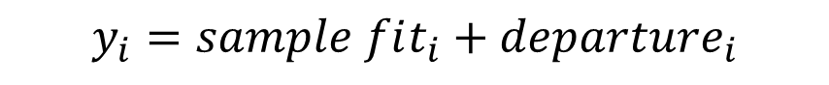
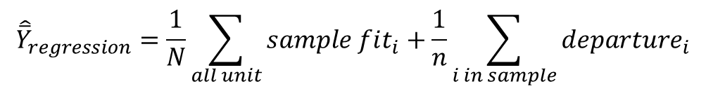
Part 1. Estimators based on sampling design
For large sample sizes regression estimators are unbiased
They are NOT based on the assumption of an existing linear relationship. In fact, the relation in the figures is a parabola.
They just take as starting point the fit between auxiliary information and variable of interest for the population.
That fit is a fixed characteristic of the population.
$$y_{i}=sample fit_{i}+departure_{i}$$
$${\hat{\overline{Y}}}_{regression}=\frac{1}{N}\sum_{all unit}{sample fit_{i}}+\frac{1}{n}\sum_{i in sample}{departure_{i}}$$

Slide 14
Part 1. Estimators based on sampling design
If the fit is strong the regression estimator works well (low variance)
If the fit is not strong the regression estimator has large variance but remains unbiased for large samples
$$y_{i}=sample fit_{i}+departure_{i}$$
$${\hat{\overline{Y}}}_{regression}=\frac{1}{N}\sum_{all unit}{sample fit_{i}}+\frac{1}{n}\sum_{i in sample}{departure_{i}}$$

Slide 15
Part 1. Estimators based on sampling design
Code session 1A
The main conclusion after the code session 1 is that the regression estimator allows using auxiliary information making the estimates more precise.
However, there is limit. If the sample size becomes too small precision degrades and the variance gets large.
The estimator is unbiased even if the data does not follow a linear relationship. In that case, the estimator will do worse but it will remain unbiased. If the relationship can be approximated well by a linear function, it will do well.

Slide 16
Part 1. Estimators based on a model
There is an alternative way of estimating quantities for a population. This is what it is called model-based estimation.
In model-based estimation we assume that the population has some structure (it follows some model) and all our inferences are based on the assumption that such model holds. This is very different from the regression estimator for which we did not assume any relationship.
The fact that we will assume that the population follows some model will change completely the way we work.

Slide 17
Part 1. Estimation based on a model
In model-based estimation we assume that every unit has an associated random variable with a distribution dictated by the model. (Randomness comes from the model)
Unlike with techniques based on the sampling design, will not look at how our estimates changes if we take different samples. We will analyze the uncertainty that arise from the random components of the model.
All our inferences will be conditioned to:
The sample that we observe
The model that we postulate for the population.

Slide 18
Part 1. Estimation based on a model
In model-based estimation we conceptualize our population in a different way:
For all population units, the variable of interest is a random variable following a specific model.
Target parameters such as means or totals will be sums or means of random variables→ Target parameters will also be random quantities with an inherent uncertainty.
This starting point entails a very important and potentially risky assumption, the model holds→To use these techniques, we will need a step to validate the model that we postulate for our population.

Slide 19
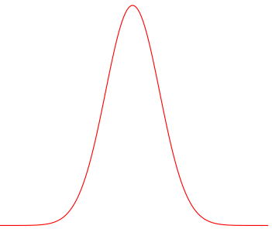
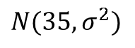
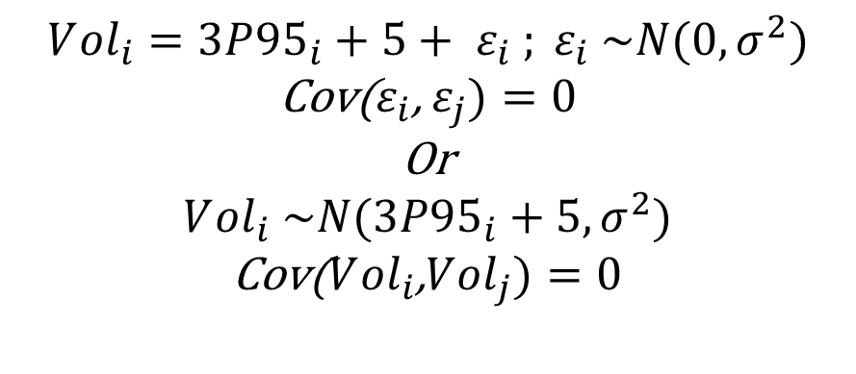
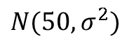

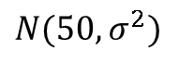

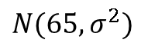
Part 1. Estimation based on a model
In model-based estimation we conceptualize our population in a different way:
For all population units, the variable of interest is a random variable following a specific model.
Target parameters such as means or totals will be sums or means of random variables→ Target parameters will also be random quantities with an inherent uncertainty.
Example:
$$N(35,σ^{2})$$
$$N(50,σ^{2})$$
Target parameter (total):
15
10
Model:
50
35
$$V{ol}_{i}=3P{95}_{i}+5+ ε_{i} ; ε_{i} \sim N(0,σ^{2})$$
Cov($ε_{i}$, $ε_{j})=0$
Or
$$V{ol}_{i} \sim N(3P{95}_{i}+5,σ^{2})$$
Cov($V{ol}_{i}$,$V{ol}_{j})=0$
$$Vol=\sum{V{ol}_{i}}$$
20
15
65
50
$$Vol\sim N(\sum{3P{95}_{i}+5},{4σ}^{2})$$
P95
$$N(65,σ^{2})$$
$$N(50,σ^{2})$$
Volume

Slide 20
Part 1. Estimation based on a model
When working with model-based methods we will have a similar workflow but with some differences.
Define our target population parameter: e.g., Mean volume in the forest, mean volume in one stand… We cannot know it and we will need a sample. This parameter will be a random variable
Collect a sample covering the maximum variability: The sample should not be collected purposively, i.e., targeting the variable of interest.
Postulate a model for the population using the sample data.
Validate the model: Check that model assumptions hold.
Calculate our estimates and uncertainties assuming the model holds: Using the collected data, calculate estimators and uncertainty based on the model.
In this case, we do not have control on the model. We can postulate and test different models but they might or might not hold. We don’t control them!!

Slide 21
Part 1. Estimators based on sampling design
Code session 1B
The main conclusion after the code session 1 is that the regression estimator allows using auxiliary information making the estimates more precise.
However, there is limit. If the sample size becomes too small precision degrades and the variance gets large.
The estimator is unbiased even if the data does not follow a linear relationship. In that case, the estimator will do worse, but it will remain unbiased. If the relationship can be approximated well by a linear function, it will do well.

